Slide 1
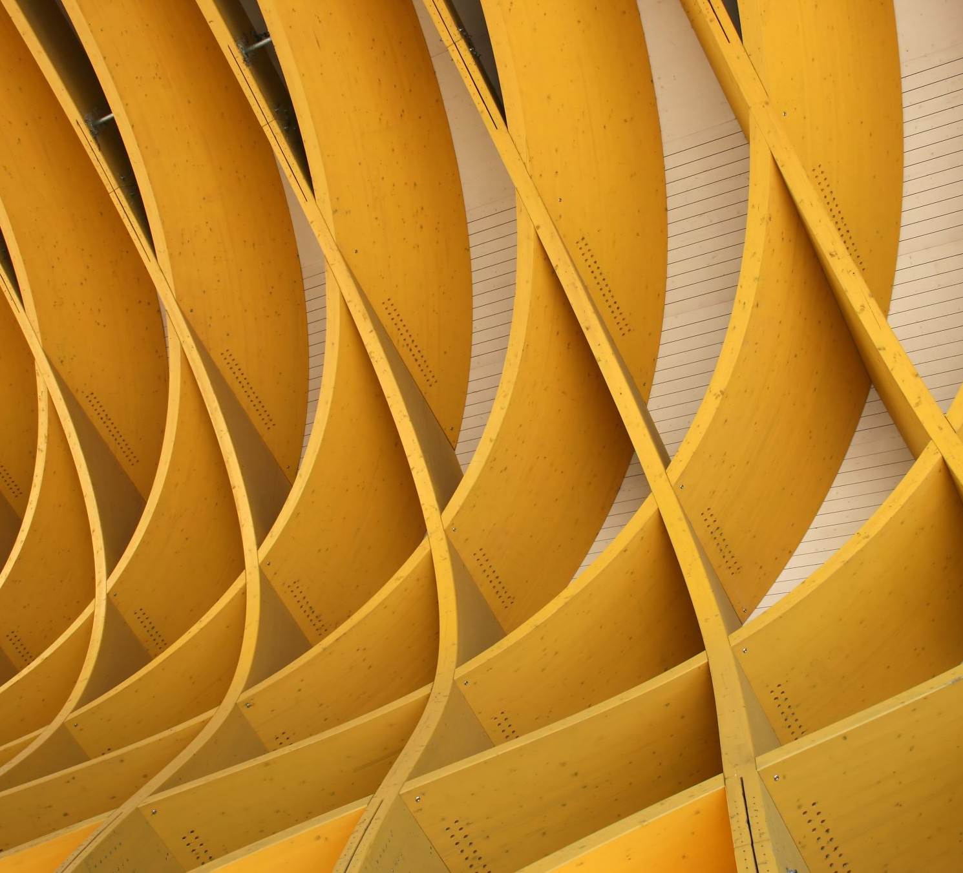
Face Tracking Robotic arm
Aman 13681085 RS1

Slide 2
Sensing: MATLAB- Computer Vision Toolbox Control: Program uses video to generate the data in form of coordinates. Dobot uses the data obtained from the code. Lab resources- Dobot & Webcam/Intel
Introduction

Slide 3
System is capable to detect face of a person and is able to track using the webcam input. System can recognise and track a particular face from a group of faces. The robotic arm is able to track and mimic the movement of the face in the given workspace.
ILC Objective

Slide 4
1. usb_cam/image_raw 2. dobot_magician_driver dobot_magician/PTP/set_cartesian_pos
Packages
&
Services

Slide 5
video
Webcam
vision.CascadeObjectDetector
Flow chart- trial2
Running in a loop to identify faces in the video
Video with square on detected faces
video
1X4 matrix
bboxes- containing coordinates and dimensions of the square
Extracting X & Y coordinates of the square
loop
Dobot

Slide 6
video
Webcam
vision.CascadeObjectDetector
RGB to Grey
Flow chart- trial4
identify corner points and save a copy
Video with square on detected faces
video
1X4 matrix
bboxPoints
reshape
bboxPolygon- Convert the box corners into the
[x1 y1 x2 y2 x3 y3 x4 y4]
Extracting X & Y coordinates of the square
loop
Dobot

Slide 7
Demo

